Slide 1
How we have done against targets for 2023

Slide 2
2023 Analysis of Variance
Mission (Our purpose)
To provide quality education based on a biblical Christian worldview enabling each child to fulfil their God-given destiny.
Vision (Our direction)
Quality education based on a biblical Christian worldview
Biblical - Relational – Transformative

Slide 3
Aidanfield Goal setting we aim very high
Our aim is for every student to achieve. We set our goals to reflect this aspiration. This means we often don’t quite reach our goals as the complexities of teaching and learning
impact outcomes.
However
we maintain high achievement rates.
we oscillate up and down within a 5% margin.
we still keep striving to do our best for every single student at Aidanfield each and every year.

Slide 4
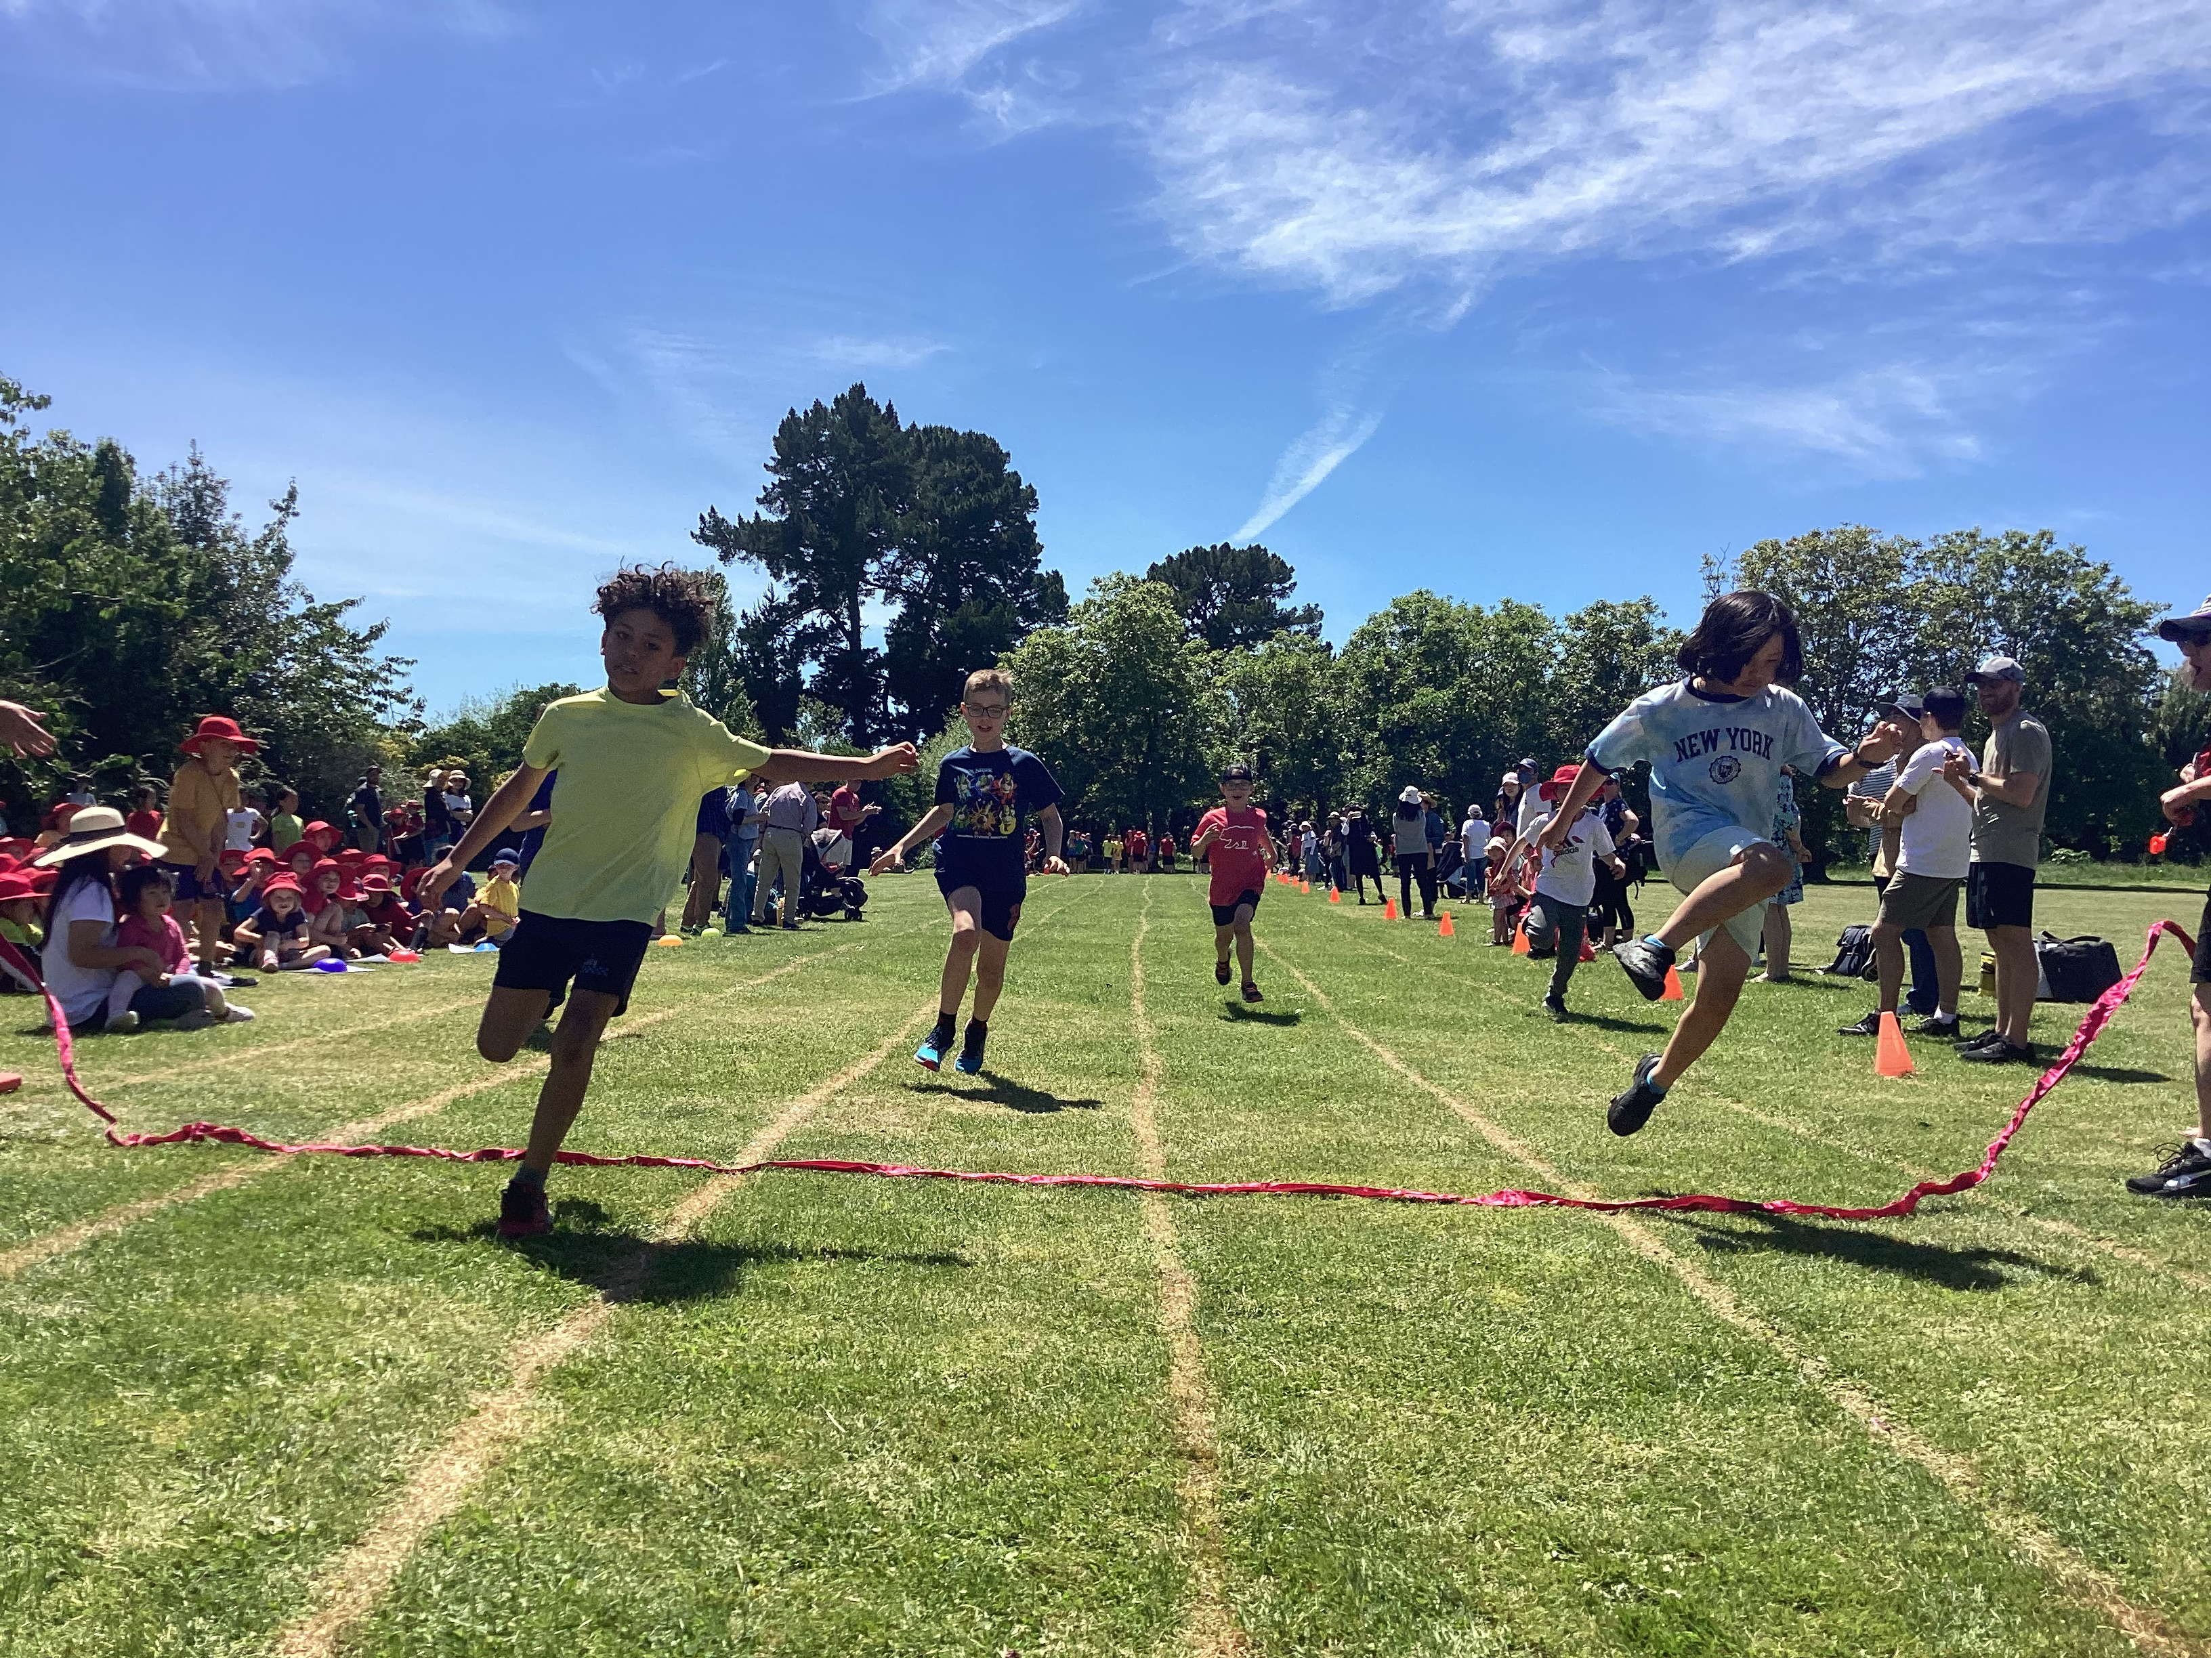
More than numbers
Data – numbers - tell a story about learning and achievement. Often there is a story within the story. Our staff have reflected on the year and the story of 2023 – things that bought them joy. These stories will be interspersed throughout this analysis of variance.
“I have loved exploring the deep questions of life with my class this year: What is the big story of the Bible and where do we fit in it? What does eternal life mean, or not mean? How can the Bible seem to contradict itself and still be true? Taking the time to address these and to challenge students to a genuine expression of an authentic faith (a life in relationship with the Trinitarian God) has added vitality and purpose to our devotional programme. I have loved working through the tough questions and seeing students reach deeper answers, deeper faith, and one even decide to get baptised. These have been the enriching and rewarding things for me.”
“The way the Y6s rose to the challenge of running the junior athletics - they actually shone at being leaders and were able to implement so many of the things we had talked about as to what makes a good leader.”
“CAMP - this was a highlight of the year for so many ... the huge growth that the children showed throughout this event was phenomenal - so many of them achieved "personal firsts" and were so proud of themselves.”

Slide 5
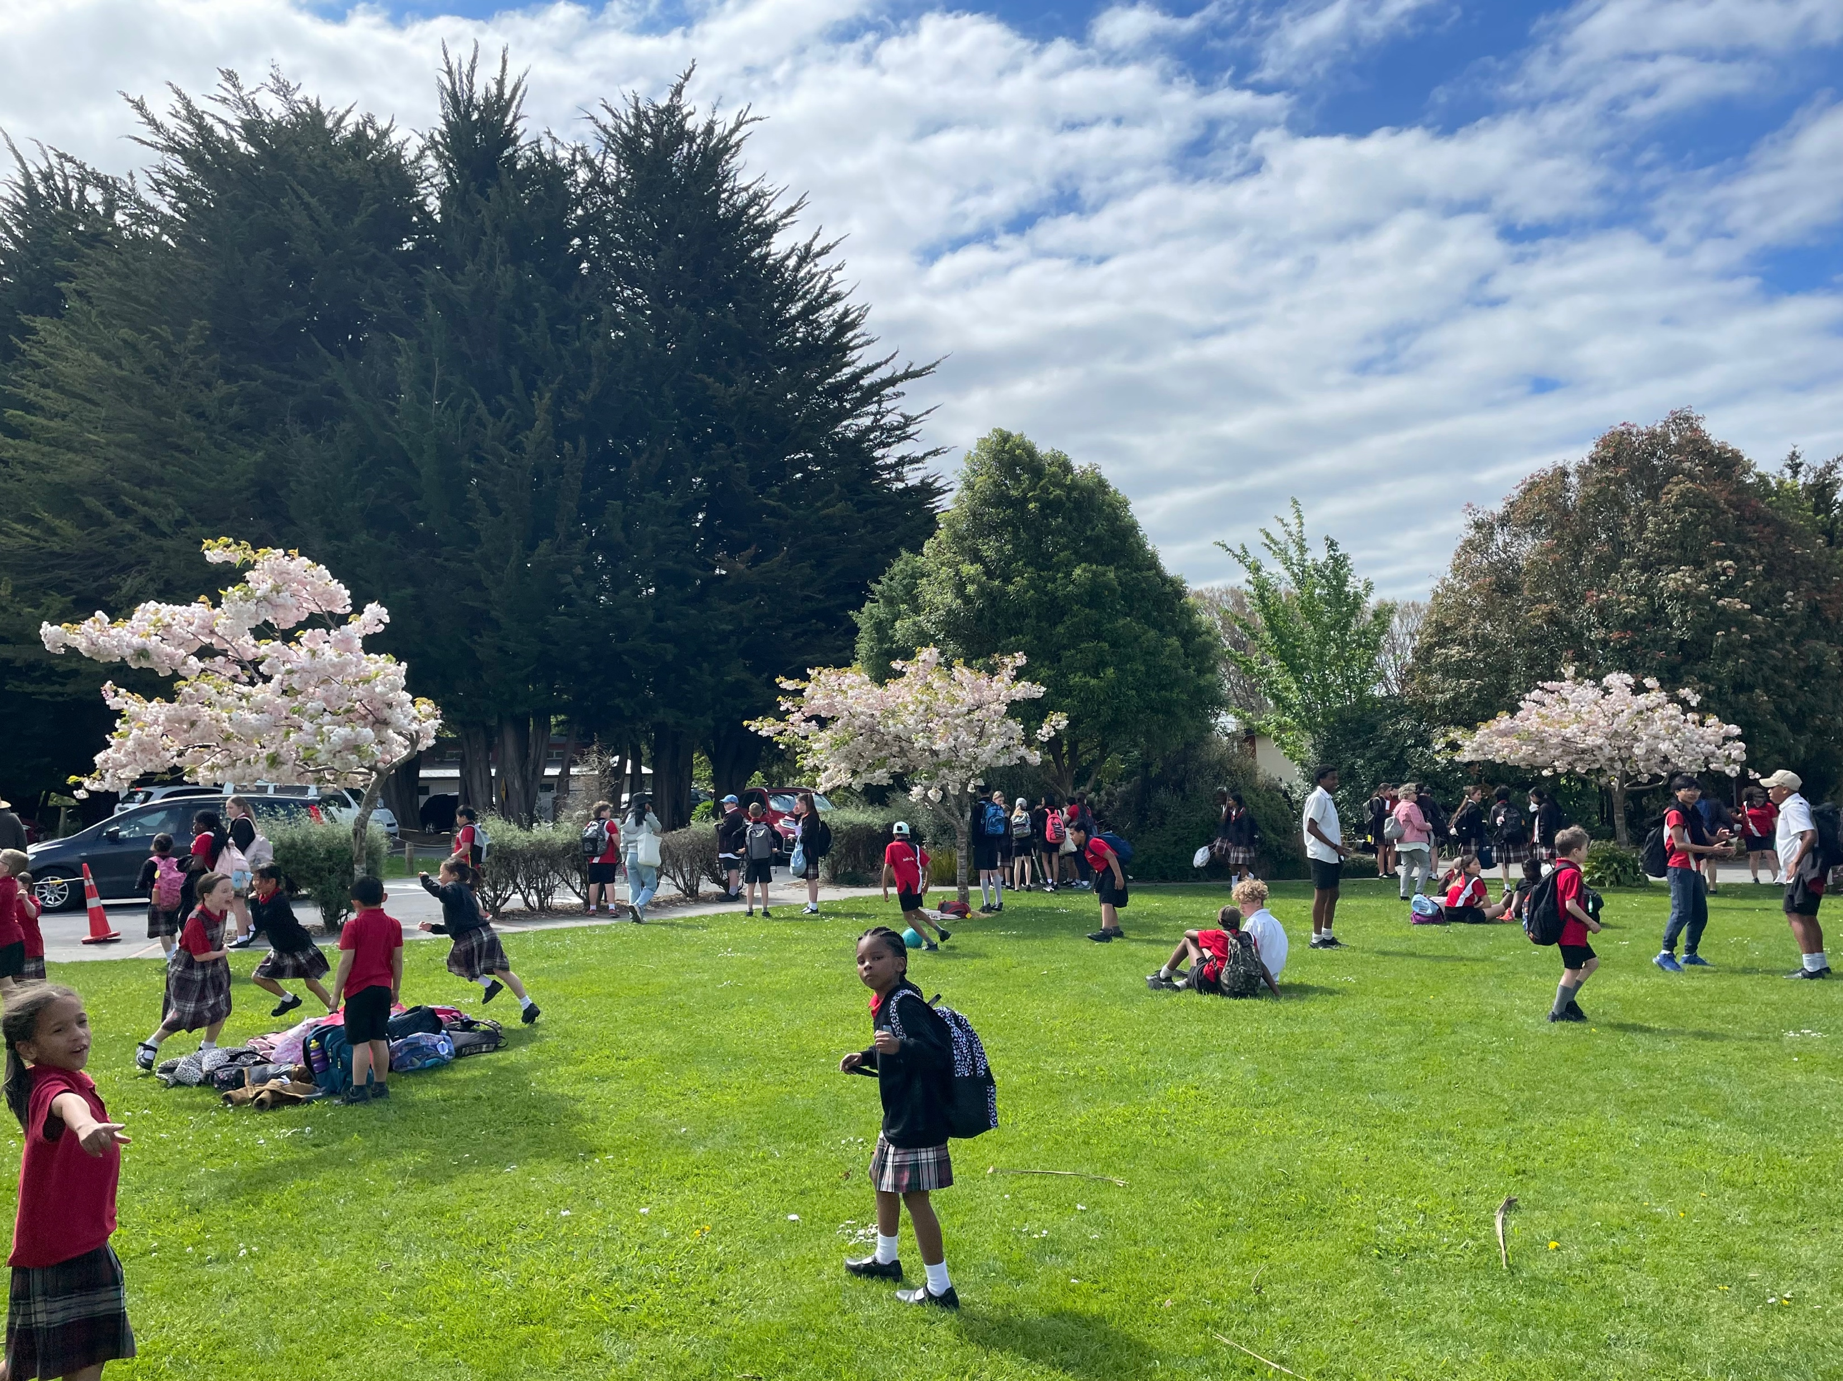
2023 Analysis of Variance
Strategic Goal 1: Quality Education based on a Biblical Christian world view
(Biblical / Transformative: Academically Able)
As a school with pupils from year 1 to 10 our priority is strong foundations in literacy and numeracy. To continue to foster excellent quality education the following areas have been identified as requiring specific focus in 2023 to enhance the overall literacy and numeracy of our pupils.

Slide 6
Reading 2023
Annual Goal:
Quality education means all pupils in years 1 to 10 will have every opportunity to achieve to their expected level (as a minimum) against the National Curriculum by the end of the year in Reading and its associated competencies
Annual Targets to achieve the goal, our annual targets for 2023 were:
Move the year 2 girls cohort to 85% of students working at or above curriculum expectations for OTJ’s in Year 3 2023
Lift the number of students who are below in standardised STAR testing in Year 3 2022 to 85% or above in the 2023 measured by Reading Comprehension PAT in Year 4 2024
Reduce the percentage of boys in year 5 2022 working below or well below expectation to 5% in Year 6, 2023.

Slide 7
Writing 2023
Annual Goal:
Quality education means all pupils in years 1 to 10 will have every opportunity to achieve to their expected level (as a minimum) against the National Curriculum by the end of the year in Writing and its associated competencies
Annual Target: to achieve the goal, our annual targets for 2023 were
Observation Survey Dictation and Writing Vocabulary to achieve 90% AT or ABOVE by end of year 2023. NB this is a continuation of a two year goal.
2022 Year 5 boys (2023 Year 6) will increase achievement levels to 85% working AT or ABOVE in writing.
All Māori and Pasifika pupils who are BELOW or WELL BELOW in 2022 will make positive shift such that 90% of Māori and Pasifika pupils achieve AT or ABOVE expectation in end of year OTJ’s 2023

Slide 8
Mathematics 2023
Annual Goal:
Quality education means all pupils in years 1 to 10 will have every opportunity to achieve to their expected level (as a minimum) against the National Curriculum by the end of the year in Mathematics and its associated competencies.
Annual Target to achieve the goal,
40% of Year 2 to 10 pupils will be in the Above category for OTJ’s which represents an upwards shift of 5% of all pupils across these.
2. 100% of Māori and Pasifika children will be at least AT expectation for OTJ’s and
PAT’s

Slide 9
Attendance 2023
High attendance rates for each pupil contributes to quality learning and solid foundational habits
Raise and maintain overall school attendance from 88% in 2018 to 94% across all year levels by the end of 2023.
Overall School Attendance
2023 = 90 %
Overall School Attendance 2021 = 95.5 % 2022 = 92%

Slide 10
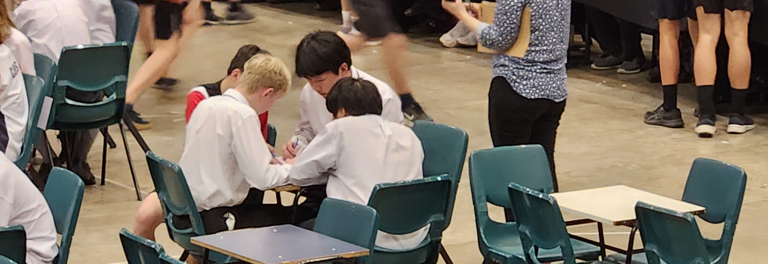
More than numbers
Data, numbers tell a story about learning and achievement. Often there is a story within the story. Our staff have reflected on the year and the story of 2023 – things that bought them joy.
“At the start of the year I got the children in my class to make a human graph showing their "likeablity of Maths" from 0-10 (0 being my worst nightmare and 10 being the best thing ever and can we do it all day). There was a very large contingent down the bottom end. At the end of the year we repeated the exercise and again I took a photo of the results. When I showed the children the 2 photos they were surprised at how much shift up there had been. Interestingly they had all remembered what their original score had been, but were surprised to see just how much everyone else had moved too! I believe that attitude is such a huge indicator of success in Maths (especially), and so it was so encouraging to hear so much more positive talk around Maths.”

Slide 11
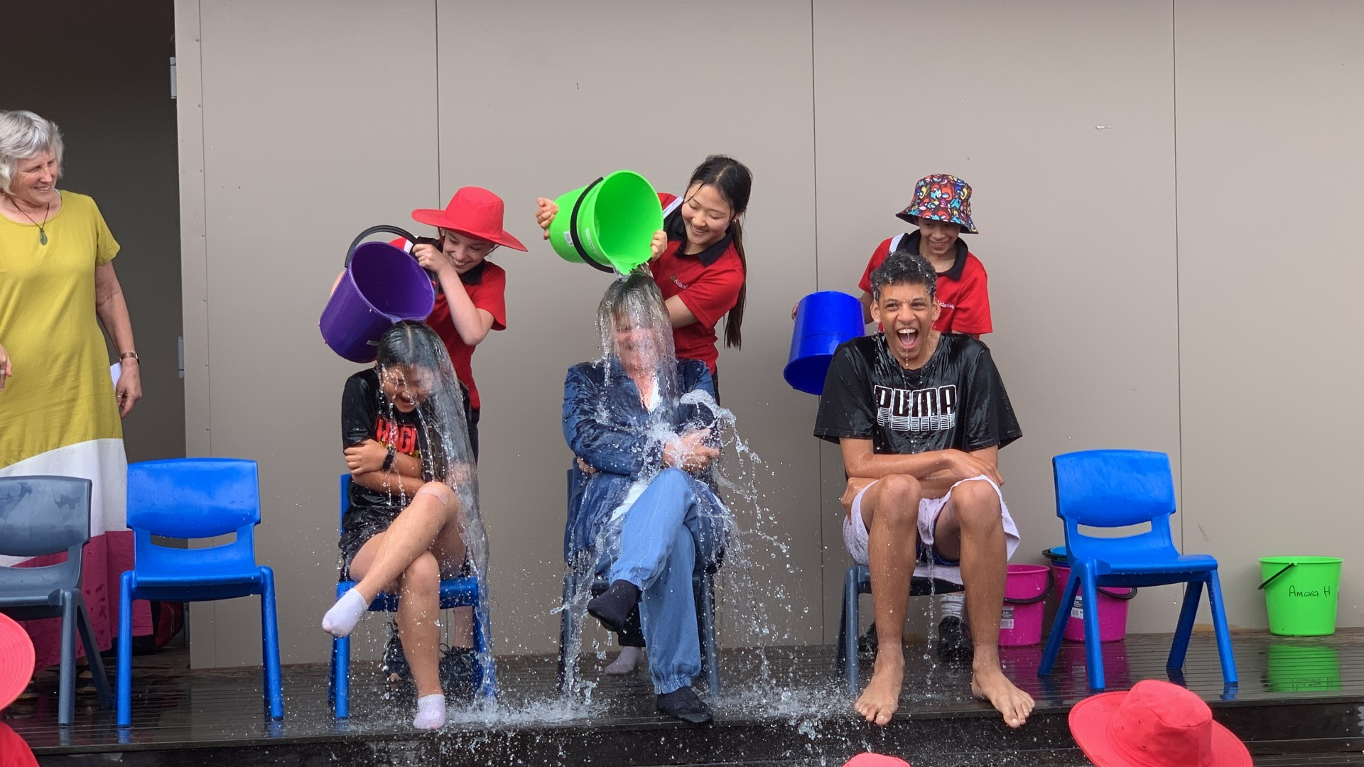
Strategic Goal 2:
Depth of Christian community across the whole school community
(Relational / Transformative: Relationally focused)
To help measure an authentic expression of Christian faith in action the Wellness at School survey has been administered in years leading up to 2022.
It was elected not to complete the survey in 2023.
This will be reviewed each year

Slide 12
Strategic Goal 3
Deepen understandings of bicultural teaching and learning through a biblical lens
(Biblical / Relational: Culturally Competent)
To continue on the path to honouring the Treaty and its expectations:
Continue Year 4 to Mārae for one day experience
Embed of Te Reo/Tikanga programme initiated 2020
Embed Te Ao Māori specialist teaching and collaboration in all classes across the school
Relationships forming with external agencies and iwi
Staff PD ongoing

Slide 13
Strategic Goal 4
Enhance opportunities for all age levels to serve the community
(Biblical / Relational: Missionally Minded)
To develop a heart of service in pupils of the school
This is a work in progress with specific focus from 2024

Slide 14
Academic Growth
Detailed review and analysis of goals and results are contained in individual reports for the following areas
Overall, we appear to be oscillating around very strong results across all areas – some years slightly up, some years slightly down – but maintaining high outcomes for most.
Reading | Fostering Strengths
Writing | English Language Earners
Mathematics | Learning Support & fostering Strengths
Reading Recovery | Te Reo

Slide 15
Year levels where expectation increases

Slide 16
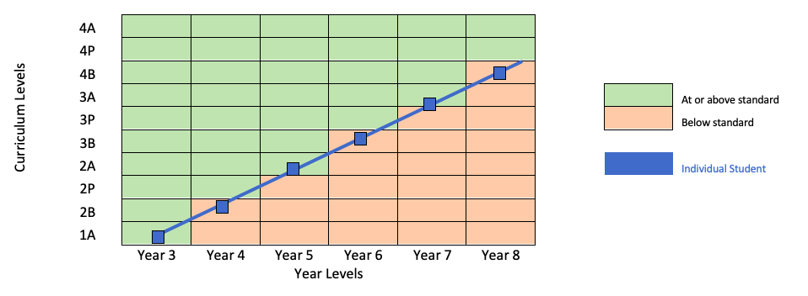
The issue of fluctuations
We have noted a trend that has pupils AT in one year and BELOW in another. The following lineal paths and reference to the slide before may explain this apparent fluctuation. We note this issue again in 2022 and now 2023.

Slide 17
Reading
Annual Goal:
Quality education means all pupils in years 1 to 10 will have every opportunity to achieve to their expected level (as a minimum) against the National Curriculum by the end of the year in Reading and its associated competencies
Annual Target to achieve the goal, our annual targets for 2023 are:
Move the year 2 girls cohort to 85% of students working At or Above curriculum expectations for OTJ’s in Year 3 2023
Lift the number of students who are Below in standardised STAR testing in Year 3 2022 to 85% or above in the 2023 measured by Reading Comprehension PAT in Year 4 2024
Reduce the percentage of boys in year 5 2022 working Below or Well Below expectation to 5% in Year 6, 2023.

Slide 18
Overall achievement Reading 2023
In 2023, we maintain high achievement across years
Year 1-10 = 85% of all students were “At or Above” expectations for OTJ Reading.
Year 1 – 8 = 88% Year 9 – 10 = 74%
2022 - 89% of all students (Year 1-10) were “At or Above” expectations for OTJ
Year 1 – 8 = 89% Year 9 – 10 = 90%
2021 - 87% of all students (Year 1-10) were “At or Above” expectations for OTJ
Year 1 – 8 = 86% Year 9 – 10 = 88%
2020 - 86% of all students (Year 1-10) were “At or Above” expectations for OT
Year 1 – 8 = 86% Year 9 – 10 = 88%
2019 - 85% of all students (Year 1-10) were “At or Above” expectations for OTJ
Year 1 – 8 = 87% Year 9 – 10 = 65%
2018 - 70% of all students (year 1-10) were “At or Above” expectations for OTJ
NB, Year 1 pupil data not included. 2018 decision to allow a year to adjust to school before making overall judgement. This will have an impact on the overall results.

Slide 19
Overall school wide Reading 2023
Arrows indicate movement of 10% or more from one year to the next
 | Yr 1 2022 | Yr 1 2023 | Yr2 2022 | Yr 2 2023 | Yr 3 2022 | Yr 3 2023 | Yr 4 2022 | Yr 4 2023 | Yr 5 2022 | Yr 5 2023 | Yr 6 2022 | Yr 6 2023 | Yr 7 2022 | Yr 7 2023 | Yr 8 2022 | Yr 8 2023 | Yr 9 2022 | Yr 9 2023 | Yr10 2022 | Yr10 2023 | 2023 Overall
Well Below # % | n/a | n/a | 0 | 0 | 2 | 1 | 0 | 1 | 0 | 0 | 1 | 0 | 0 | 2 | 2 | 0 | 1 | 3 | 1 | 4 | 11
 |  |  | 0 | 0 | 4 | 3 | 0 | 2 | 0 | 0 | 3 | 0 | 0 | 5 | 6 | 0 | 3 | 10 | 5 | 11 | 3
Below # % | n/a | n/a | 7 | 3 | 4 | 5 | 4 | 8 | 4 | 2 | 4 | 4 | 2 | 2 | 0 | 4 | 3 | 4 | 0 | 6 | 38
 |  |  | 21 | 8 | 9 | 15 | 10 | 19 | 9 | 5 | 11 | 10 | 6 | 5 | 0 | 11 | 10 | 13 | 0 | 17 | 11
At # % | n/a | n/a | 17 | 19 | 20 | 15 | 21 | 19 | 23 | 20 | 17 | 25 | 16 | 15 | 21 | 13 | 14 | 14 | 5 | 13 | 153
 |  |  | 52 | 51 | 44 | 44 | 54 | 44 | 52 | 51 | 46 | 60 | 50 | 41 | 60 | 37 | 45 | 45 | 25 | 37 | 46
Above # % | n/a | n/a | 9 | 15 | 19 | 13 | 14 | 15 | 17 | 17 | 15 | 13 | 14 | 18 | 12 | 18 | 13 | 10 | 14 | 12 | 131
 |  |  | 27 | 41 | 42 | 38 | 36 | 35 | 39 | 44 | 41 | 31 | 44 | 49 | 34 | 51 | 42 | 32 | 70 | 34 | 39
Total # % | n/a | n/a | 33 | 37 | 45 | 34 | 39 | 43 | 44 | 39 | 37 | 42 | 32 | 37 | 35 | 35 | 31 | 31 | 20 | 35 | 333
 |  |  | 100 | 100 | 100 | 100 | 100 | 100 | 100 | 100 | 100 | 100 | 100 | 100 | 100 | 100 | 100 | 100 | 100 | 100 | 100

Slide 20
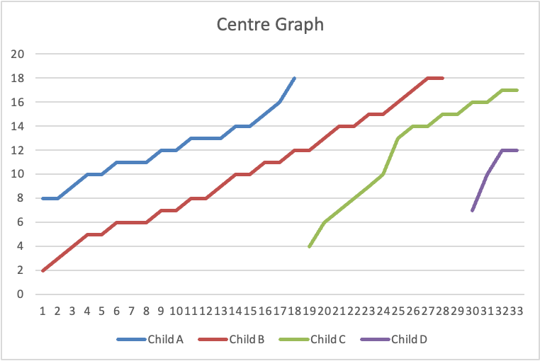
Reading Recovery 2023
Reading Recovery provides daily one to one teaching with a specially trained teacher for children making the slowest progress in literacy after one year at school.
2023
4 children on the programme
Good movement for all children
2023 progress graph
Ongoing monitoring
We monitor the progress of children who have completed the Reading Recovery programme in the last three years.
16 currently monitored
1 is reading ABOVE expectation
11 are reading AT expectation
4 are reading BELOW expectation

Slide 21
Trending Male / Female reading 2023
Female pupils
2023 = 147/169 (86%) females At or Above curriculum level for their year level
2022 = 141/156 (90%) females At or Above curriculum level for their year level
2021 = 137/154 (88%) females At or Above curriculum level for their year level
2020 = 123/141 (87%) females At or Above curriculum level for their year level
2019 female pupils 95/136 (69%) At or Above
Male pupils
2023 = 137/164 (83%) males At or Above curriculum level for their year level
2022 = 140/160 (87%) males At or Above curriculum level for their year level
2021 = 84/173 (84%) males At or Above curriculum level for their year level
2020 = 134/162 (82%) pupil At or Above curriculum level for their year level
2019 male pupils 109/138 (78%) At or Above curriculum
Well below category for age based curriculum level
2023 = 27/164 (16%) males and 22/169 (13%) females
2022 = 4/160 (2%) males and 3/156 (1%) females
2021 = 9/173 (5%) males and 3/154 (1%) females
2020 = 10/162 (6%) males and 2/141 (1%) females
2019 = 11/138 (7%) males and 14/136 (10%) females

Slide 22
Male and female difference reading 2023
In 2023
Increase in the number of boys and girls ‘Below’/’Well Below’ in 2023 compared to 2022 (16% compared to 13% in 2022)
Males working ‘At’ expectation has remained consistent (49%)
Females working ‘At’ expectation has decreased from 49% to 43%, however, the ‘Above’ category has increase slightly to 44%.
While overall results have dipped in 2023 the variations seen
over the last 4 years generally oscillate through a 5% range.
No concerning negative trends are identified.

Slide 23
Trending Ethnicity reading 2023
Maori pupils 14/17pupils achieving At or Above expectation (82%),
2022 14/16 pupils achieving At or Above expectation (87%),
2021 13/15 pupils achieving At or Above expectation (86%),
2020 10/12 pupils achieving At or Above curriculum expectation (83%),
2019 7/9 pupils achieving At or Above curriculum expectation (78%)
Pasifika pupils = 14/16 pupils achieving At or Above expectation (88%),
2022 9/10 pupils achieving At or Above expectation (90%),
2021 11/13 pupils achieving At or Above expectation (84%),
2020 11/13 pupils achieving At or Above expectation (84%),
2019 5 / 7 pupils achieving At or Above curriculum expectation (71%)
Asian pupils = 125/142 pupils achieving At or Above expectation (88%)
2022: 113/126 pupils achieving At or Above expectation (89%)
2021: 116/137 pupils achieving At or Above expectation (84%)
2020: 95/114 pupils achieving At or Above curriculum expectation (83%)
NZ Pākehā = 115/135 pupils achieving At or Above expectation (86%)
2022: 136/150 pupils achieving At or Above expectation (90%)
2021: 121/135 pupils achieving At or Above expectation (89%)
2020: 118/137 pupils achieving At or Above curriculum expectation (86%)

Slide 24
Monitoring English Language Learners - Reading
ACS Aim:
All English Language Learners will show shift within the ELLPs over a 2 year period. The research suggests that it can take 5-7 years to learn academic language (Ministry of Education, 2008), so this is significant progress in only two years.
Of the 60 identified ELL students (Year 2 and above) at ACS in 2021,
78% (47/60) are at or above curriculum level in reading in 2023

Slide 25
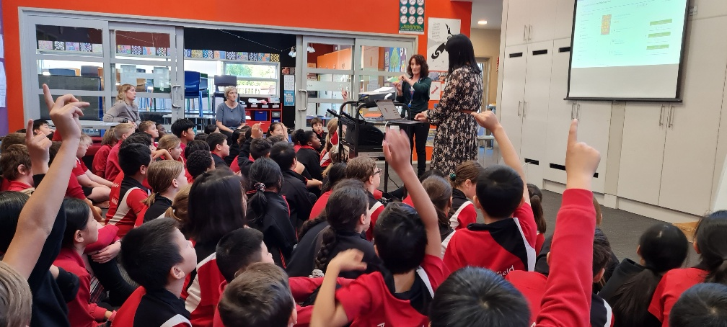
2023 Targets reading
.
Move the year 2 girls cohort to 85% of students working At or Above curriculum expectations for OTJ’s in Year 3 2023
Total number of girls in Year 3 cohort, 2023 | Number = 21
Total number and percentage of girls in Year 3 cohort, 2023 achieving AT or ABOVE in end of year OTJs | Number = 16 % = 71%
While the target was not achieved, there was a 6% movement of girls from BELOW to AT
2. Lift the number of students who are Below in standardised STAR testing in Year 3, 2022 to 85% or above in the 2023 measured by Reading Comprehension PAT in Year 4, 2023
Total number of pupils in the Year 4 cohort in 2023 | Number = 43
Total number and percentage of pupils in Year 4, 2023, who were AT or ABOVE expectation in the end of year OTJ, 2023. | Number 34 | % 79%
Target missed by 2.6 students

Slide 26
2023 Target Three reading
3. Reduce the percentage of boys in year 5 2022 working below or well below expectation to 5% in Year 6, 2023.
Total number of boys in years 6, 2023 | Number 20 | % 100%
Total number and percentage of boys in years 6 2023 who achieved BELOW or WELL BELOW in reading at years end 2023 | Number 4 | % 20%
This group remains a focus for improvement over time.

Slide 27
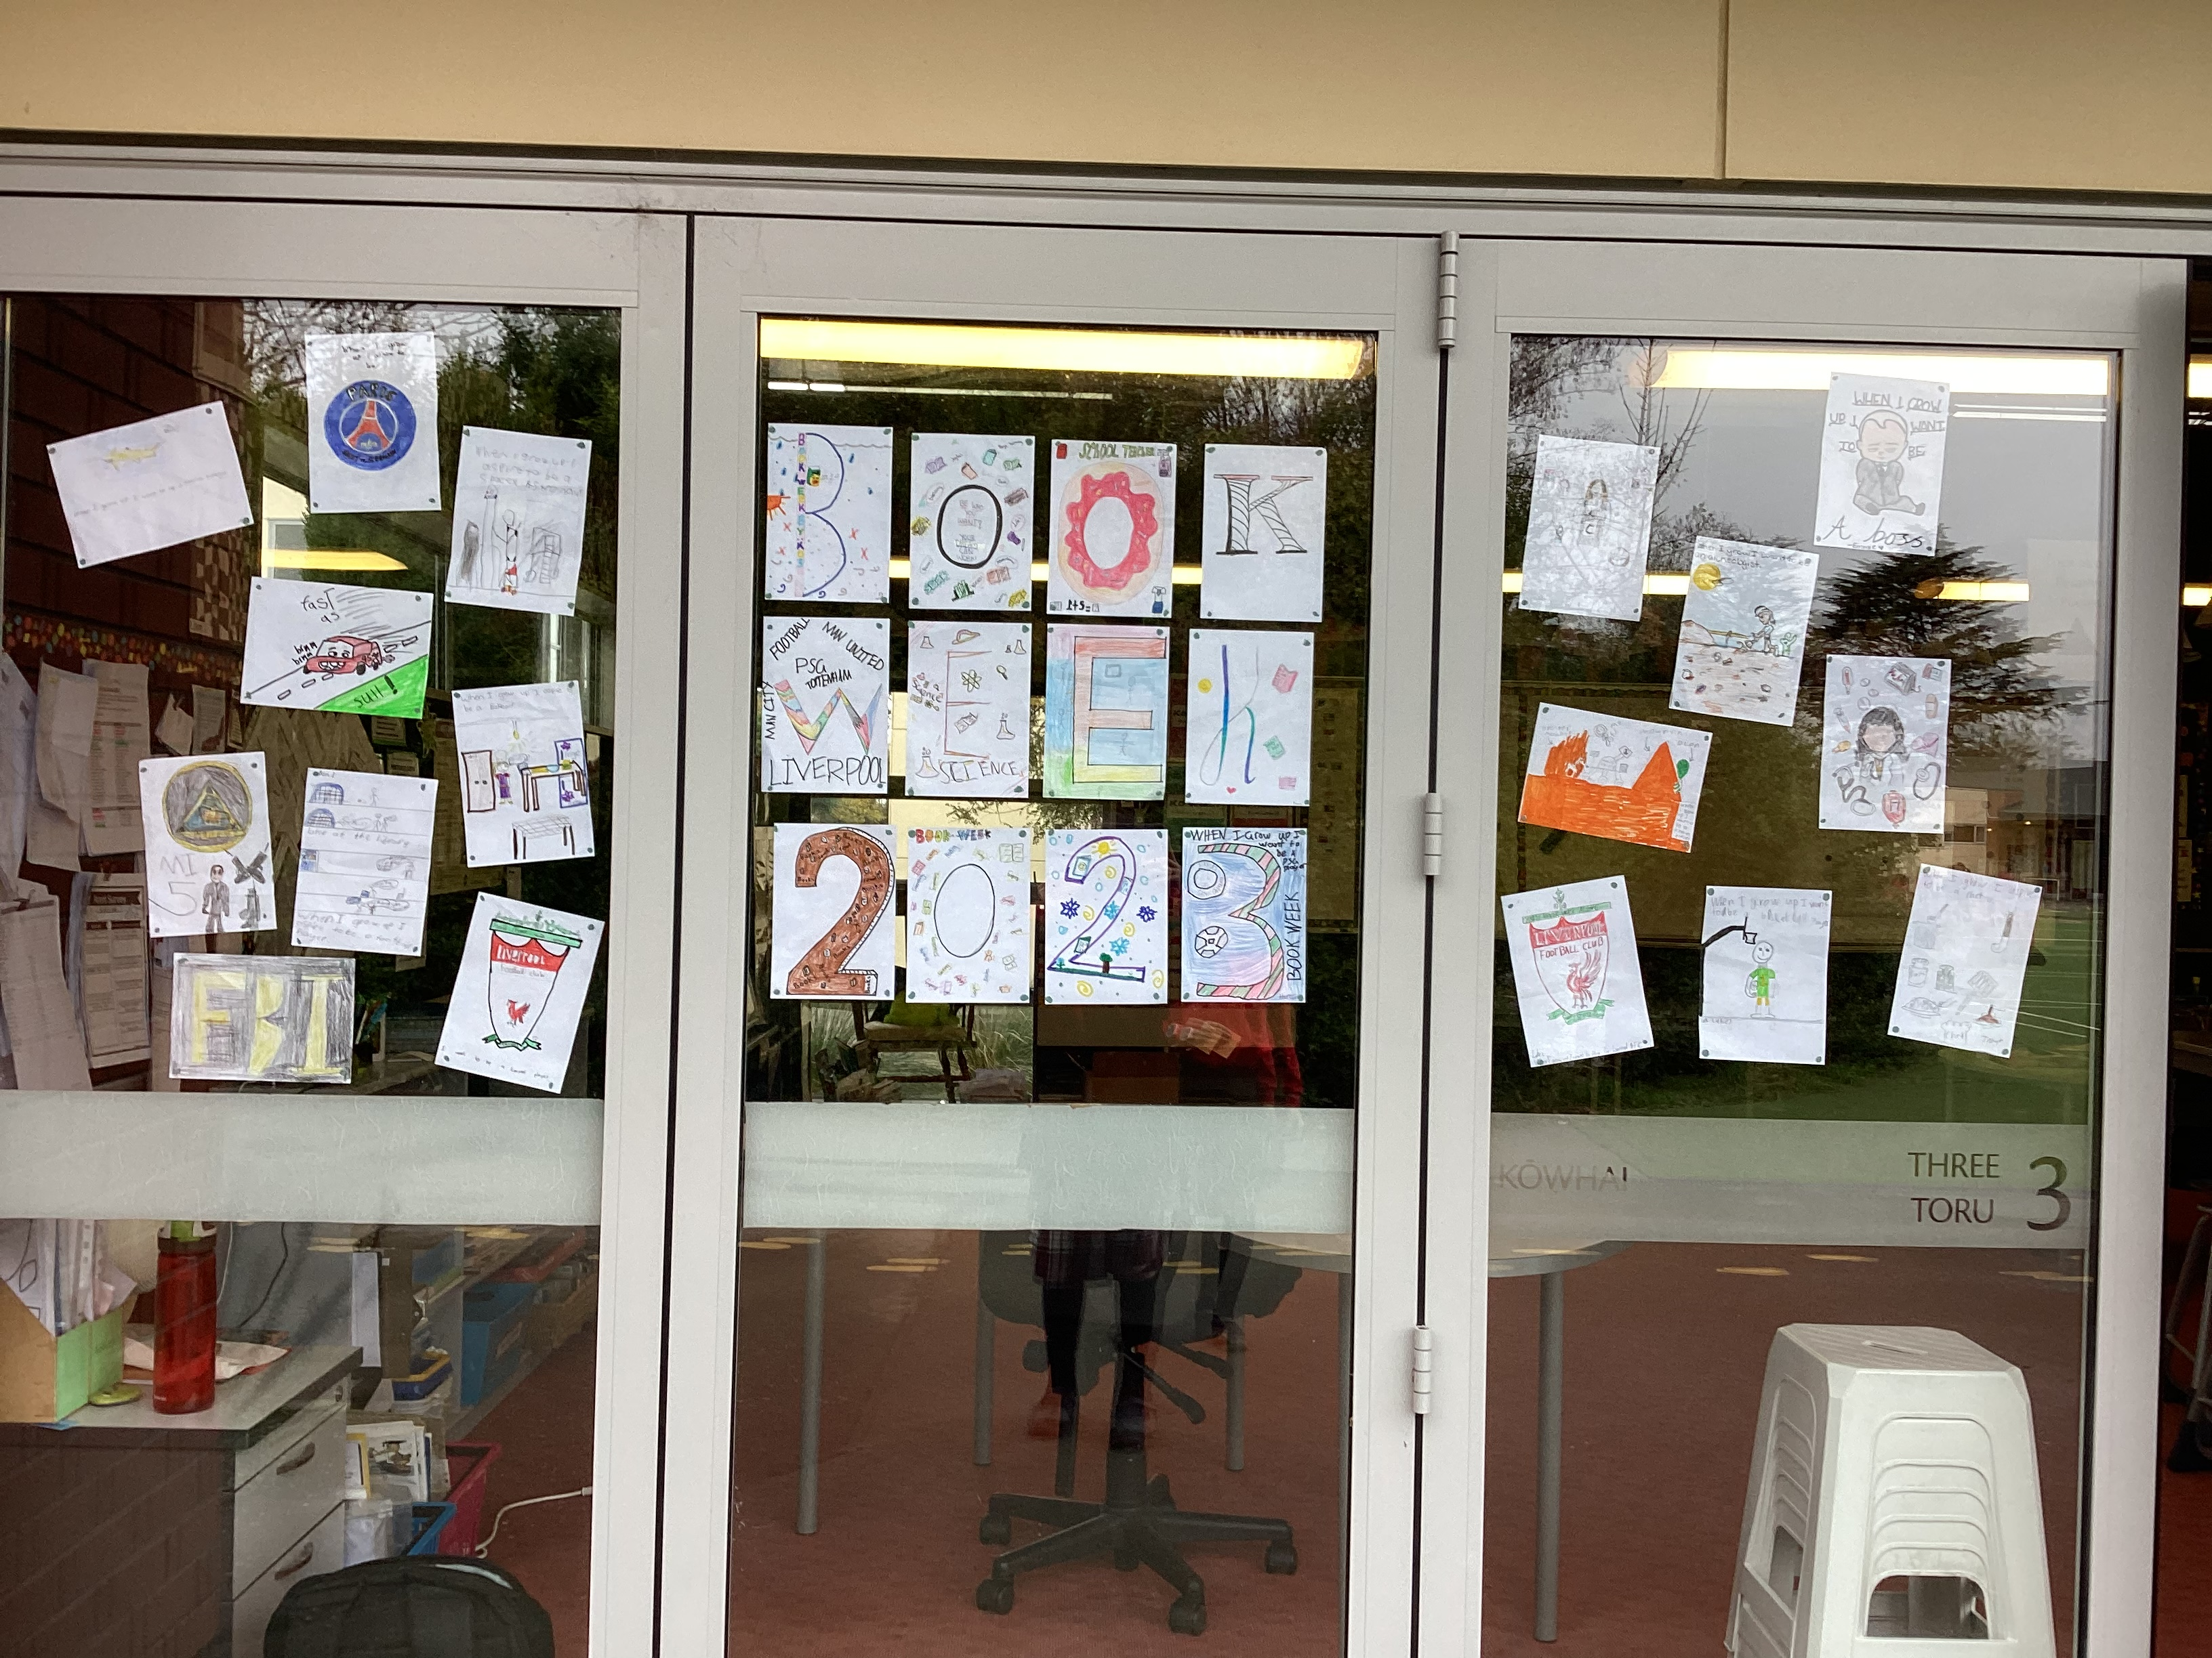
Annual Goal Reading 2023
Quality education means all pupils in years 1 to 10 will have every opportunity to achieve to their expected level (as a minimum) against the National Curriculum by the end of the year in Reading and its associated competencies. Although we did not meet our target, there are things to celebrate as we offered every opportunity to succeed!
Of pupils who were below or well below:
11 (35%) students moved up a category
19 (61%) students made no change in category
2 (6%) students moved down a category:

Slide 28
Annual Goal Reading 2023
Quality education means all pupils in years 1 to 10 will have every opportunity to achieve to their expected level (as a minimum) against the National Curriculum by the end of the year in Reading and its associated competencies. Although we did not meet our target, there are things to celebrate as we offered every opportunity to succeed!
Worth celebrating:
In 2023, 85% of all students (Year 1=10) were “At or Above” expectations for OTJ Reading
Junior School data - BSLA shift very evident in the 6 year Observational Survey data and flowing through to the Year 2 cohort
Males pupils net positive increase for PAT – particularly the Above category
Māori pupils positive shift in the Above Category
No disparity across the ethnicities

Slide 29
Potential 2024 focus areas Reading
6 Year Observational Survey – to increase the number of children in the Above category to at least 20% - Intentionally teaching the Concept About Prints skills
Year 4 (Year 5, 2025) – shift 10% out of the Below/Well Below group into At/Above for OTJ’s
Year 9 (Year 10, 2024) – wrap extra support around this cohort, to raise achievement levels. 77% of this year level are working at or above according to teacher OTJ’s while PAT data places 55% of students at or above. Aim for consistency OTJ-PAT, within 10%
PAT Females 47% drop to 28% Above average.
Target: aim for 40% in the Above category (10%
upwards shift)

Slide 30
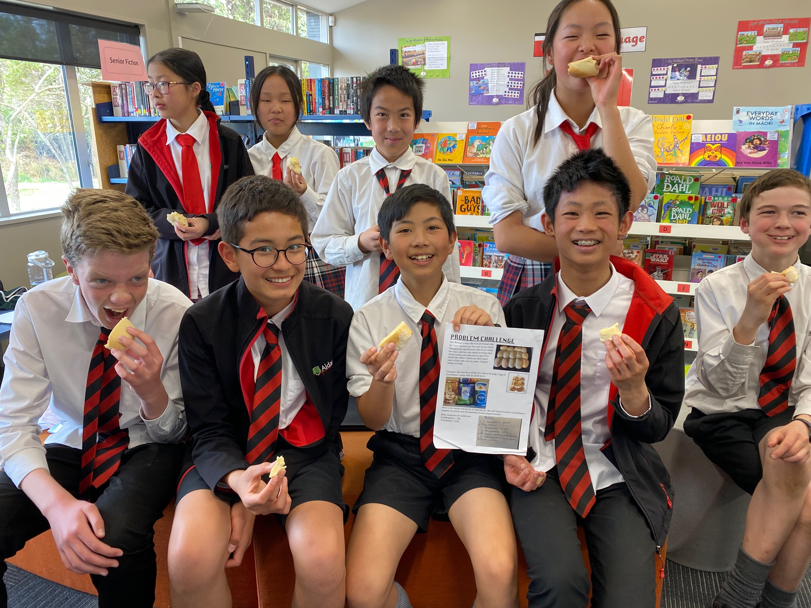
More than numbers
Data – numbers - tell a story about learning and achievement. Often there is a story within the story. Our staff have reflected on the year and the story of 2023 – things that bought them joy.
“I've had several instances this year where I've been reminded of the absolute care and love that the staff here have for the students under their care. For me, it's in the day-to-day dealings I observe - a kind word to a discouraged child, an apology to a colleague for something not handled as well as intentioned, a genuine question asking after a family member who has been unwell or absent. I think these things cannot be underestimated in their impact. This year I have appreciated the safe place we provide for our students and staff. I have appreciated that we are 'seen' and that our students and whānau are 'seen'. I appreciate that I am seen and my own children are seen and loved. People are complex, but God's faithfulness is evident in this place.”
“What has impressed me this year in particular is the adaptability of the students moving classrooms multiple times. They coped so well and just got on with learning. They showed patience and joy at new (and old) surroundings. This new generation is truly stunning in their ability to be adaptable and cope well with change and flux.”

Slide 31
writing 2023
Annual Goal:
Quality education means all pupils in years 1 to 10 will have every opportunity to achieve to their expected level (as a minimum) against the National Curriculum by the end of the year in Writing and its associated competencies
Annual Target to achieve the goal, our annual targets for 2023 are:
Observation Survey Dictation and Writing Vocabulary to achieve 90% AT or ABOVE by end of year 2023. NB this is a continuation of a two year goal.
2022 Year 5 boys (2023 Year 6) will increase achievement levels to 85% working AT or ABOVE in writing.
All Māori and Pasifika pupils who are BELOW or WELL BELOW in 2022 will make positive shift such that 90% of Māori and Pasifika pupils achieve AT or ABOVE expectation in end of year OTJ’s 2023

Slide 32
Overall school wide Writing 2023
In 2023 we see a overall results improving year to year
Year 1-10 - 82% of all students were “At or Above” expectations for OTJ Reading.
Year 1 – 8 = 84% Year 9 – 10 = 73%
2022 - 88% of all students (Year 1-10) were “At or Above”
2021 - 80% of all students (Year 1-10) were “At or Above”
2020 - 81% of all students (Year 1-10) were “At or Above
2019 - 76% of all students (Year 1-10) were “At or Above”
2018 - 77% of all students (year 1-10) were “At or Above”
NB, Year 1 pupil data not included. 2018 decision to allow a year to adjust to school before making overall judgement. This will have an impact on the overall results. Year 1 levels are similar to previous years.

Slide 33
Overall expectation writing 2023
Percentage of students working ‘Well Below’ standard
2023 = 4% 2022 = 4% 2021 = 4% : 2020 = 3% 2019 = 5%
Percentage of students working ‘Below’ standard
2023 = 14% 2022 = 8% 2021 = 16% 2020 = 16% 2019 = 20%,
The percentage of students working ‘At’ standard
2023 = 59% 2022 = 62% 2021 = 59% 2020 = 65% 2019 = 64%
The number of students working at ‘Above’ standard
2023 = 23% 2022 = 26% 2021 = 21% 2020 = % 16 2019 = 12%

Slide 34
overall data Writing 2023
 | Year 3 2023 |  | Year 4 2023 |  | Year 5 2023 |  | Year 6 2023 |  | Year 7 2023 |  | Year 8 2023 |  | Year 9 2023 |  | Year 10 2023 |  | Overall
 | 2022 | 2023 | 2022 | 2023 | 2022 | 2023 | 2022 | 2023 | 2022 | 2023 | 2022 | 2023 | 2022 | 2023 | 2022 | 2023 | 2022 | 2023
Well Below | 0 | 3 | 13 | 5 | 13 | 3 | 3 | 2 | 0 | 8 | 3 | 0 | 6 | 6 | 5 | 9 | 4 | 4
Below | 12 | 18 | 7 | 21 | 7 | 5 | 8 | 17 | 16 | 8 | 6 | 17 | 3 | 19 | 0 | 20 | 8 | 14
At | 73 | 62 | 56 | 63 | 56 | 74 | 74 | 64 | 68 | 57 | 63 | 49 | 60 | 39 | 20 | 40 | 62 | 59
Above | 15 | 18 | 24 | 12 | 24 | 18 | 15 | 17 | 16 | 27 | 28 | 34 | 31 | 35 | 75 | 31 | 26 | 23
Percentage shift from last year to this year by cohort
Arrows indicate movement of 10% or more from one year to the next

Slide 35
Male / Female years 1-10 writing 2023
Female pupils 2023 = 88% female pupils At or Above curriculum level
2022 female pupils 90% At or Above
2021 female pupils 88% At or Above
2020 female pupils 88% At or Above
2019 female pupils 85% At or Above
Male pupils 2023 = 77% male pupils At or Above curriculum level
2022 = male pupils 85% At or Above
2021 = male pupils 85% At or Above
2020 = male pupils 74% At or Above
2019 = male pupils 67% At or Above
Well below 2023 = 11/164 (6%) males and 2/169 (1%) females
2022 = 6/159 (3%) males and 7/156 (4%) females
2021 = 9/173 (5%) males and 4/154 (3%) females
2020 = 8/161 (4%) males and 2/141 (1%) females
2019 = 10/138 (7%) males and 2/118 (1%) females

Slide 36
Ethnicity For years 1 - 10 writing 2023
Māori pupils 2023 = 14/17 (82%) At or Above curriculum level
2022 = 13/16(82%) pupils At or Above
2021 = 12/15 (80%) pupils At or Above
2020 = 10/12 (83%) pupils At or Above
2019 = 6/9 (66%) pupils At or Above
Pasifika pupils 2023 = 15/16 (93%) At or Above curriculum level
2022 = 8/10(80%) pupils At or Above
2021 = 11/13 (85%) pupils At or Above
2020 = 9/14 (64%) pupils At or Above
2019 = 3/7 (42%) pupils At or Above
Asian pupils 2023 = 119/142 (83%) At or Above curriculum level
2022 = 114/126 (90%) pupils At or Above
2021 = 112/137 (81%),pupils At or Above
2020 = 93/114 (81%) pupils At or Above
NZ Pākehā pupils 2023 = 109/135 (80%) At or Above curriculum level
2022 = 132/150 (88%) pupils At or Above
2021 = 110/135 (81%),pupils At or Above
2020 = 112/136 (82%) pupils At or Above

Slide 37
Target one Writing 2023
Junior School – Observation Survey Dictation and Writing Vocabulary aim - to achieve 90% At or Above by 2023 (two-year goal with the introduction of Better Start).
Total number of pupils at ACS in 2022 who have been assessed in the Observational Survey Dictation and Writing Vocabulary assessments | Number = 35
Total number and percentage of pupils at ACS in 2022 who have been assessed in the Observational Survey Dictation and Writing Vocabulary assessments AND who have achieved 90% or above. | Number 26 |  | % 74%
Total number of pupils at ACS in 2023 who have been assessed in the Observational Survey Dictation and Writing Vocabulary assessments | Number = 54
Total percentage of pupils at ACS in 2023 at or above in both assessments | Number 50 | % 94%
Have we achieved 90% of eligible pupils who were assessed at 90% or above by the end of 2023? | YES
Comment This is a very good percentage rate for students ‘at’ or ‘above’ in both assessments. The BSLA programme is still in its infancy at ACS, but initial results are promising

Slide 38
Target two Writing 2023
All Māori and Pasifika pupils who are BELOW or WELL BELOW in 2022 will make positive shift such that 90% of Māori and Pasifika pupils achieve AT or ABOVE expectation in end of year OTJ’s 2023
Māori pupils
Total number of pupils who identify as Māori at ACS in 2023 who are in Year 2 and above | Number = 17
Total number and percentage of pupils who identify as Māori ACS, 2023, who are in year 2 and above who are AT or ABOVE expectation in the end of year OTJ. | Number 14 | % 82%
Are 90% or more of all pupils who identify as Māori ACS, 2023, in year 2 and above AT or ABOVE? | NO – 1 child off target
Pasifika pupils
Total number of pupils who identify as Pasifika at ACS in 2023 who are in Year 2 and above | Number = 14
Total number and percentage of pupils who identify as Pasifika ACS, 2023, who are in year 2 and above who are AT or ABOVE expectation in the end of year OTJ. | Number 13 | % 93%
Are 90% or more of all pupils who identify as Pasifika ACS, 2023, in year 2 and above AT or ABOVE? | YES

Slide 39
Target Three Writing 2023
Year 6, 2023, will increase achievement levels to 85% working AT or ABOVE in writing
Total number of boys at ACS in 2023 who are in Year 6 | Number = 20
Total number and percentage of boys at ACS, 2023, who are in year 6 who are AT or ABOVE expectation in the end of year OTJ. | Number 13 | % 65
Are 85% or more of all boys at ACS, 2023, in year 6 achieving AT or ABOVE expectation in the end of year OTJs? | NO

Slide 40
Annual Goal Writing 2023
Quality education means all pupils in years 1 to 10 will have every opportunity to achieve to their expected level (as a minimum) against the National Curriculum by the end of the year in Writing and its associated competencies
We did not achieve our goal - 82% of all students achieved ‘At’ or ‘Above’ their expected level.
47% of those students who were achieving ‘Below’ or ‘Well Below’ in 2022, made accelerated progress with a shift of 1 or more levels in 2023.
Year 8 boys have shown particular improvement, with a 20% reduction in Below/Well Below, and a 20% increase in Above for OTJ’s.
Year 2 had 97% of students achieving At or Above expected level
Year 3 boys surpass girls in writing achievement.
BSLA data suggests this new programme is supporting increased achievement levels for students in the junior school with very encouraging results in the data collected.
93% of Pasifika students are achieving ‘At’ or ‘Above’.

Slide 41
Potential 2024 focus areas writing
Suggested Targets:
Raise the achievement of our Māori students to have 85% achieving ‘At’ or ‘Above’ by the end of 2024.
Monitor the 2023 Year 2 to ensure the positive achievement levels are maintained.
85% of boys across the school achieving ‘At’ or ‘Above’ in Writing in 2024, with particular focus on boys in Year 4, 6, 8 and 9 (2023).
Year 5 cohort (Year 4 in 2023) reverse the downward trend (of those achieving At or Above expected level) that has been occurring over the last four years.
Monitor 2023 Year 8 cohort to check the general trend in achievement levels rises to reflect past fluctuations.

Slide 42
Maths
Annual Goal:
Quality education means all pupils in years 1 to 10 will have every opportunity to achieve to their expected level (as a minimum) against the National Curriculum by the end of the year in Mathematics and its associated competencies
Annual Target to achieve the goal:
40% of Year 2 to 10 pupils will be in the Above category for OTJ’s which represents an upwards shift of 5% of all pupils across these.
2. 100% of Māori and Pasifika children will be at least AT expectation for OTJ’s and
PAT’s

Slide 43
School wide achievement Mathematics 2023
In 2023 strong achievement in Mathematics continues
Year 1-10 = 89% of all students were “At or Above”
expectations for OTJ Mathematics.
Year 1 to 8 = 91% Year 9 and 10 = 85%
2022 91% of all students were “At or Above”; Year 1 to 8 = 90% Year 9 – 10 = 98%
2021 89% of all students were “At or Above”; Year 1 to 8 = 88% Year 9 – 10 = 92%
2020 88% of all students were “At or Above”; Year 1 to 8 = 88% Year 9 – 10 = 89%
2019 85% of all students were “At or Above”; Year 1 to 8 = 87% Year 9 – 10 = 76%
NB, Year 1 pupil data not included. 2018 decision to allow a year to adjust to school before
making overall judgement. This will have an impact on the overall results. Year 1
levels are similar to previous years.

Slide 44
Overall data Mathematics 2023
 | Year 3 2023 |  | Year 4 2023 |  | Year 5 2023 |  | Year 6 2023 |  | Year 7 2023 |  | Year 8 2023 |  | Year 9 2023 |  | Year 10 2023 |  | Overall
 | 2022 | 2023 | 2022 | 2023 | 2022 | 2023 | 2022 | 2023 | 2022 | 2023 | 2022 | 2023 | 2022 | 2023 | 2022 | 2023 | 2022 | 2023
Well Below | 0 | 0 | 4 | 2 | 0 | 0 | 0 | 0 | 0 | 3 | 0 | 0 | 0 | 19 | 0 | 0 | 1 | 2
Below | 12 | 12 | 7 | 16 | 8 | 5 | 9 | 14 | 14 | 0 | 9 | 9 | 3 | 6 | 3 | 6 | 8 | 8
At | 73 | 62 | 51 | 56 | 41 | 46 | 75 | 69 | 70 | 35 | 38 | 40 | 37 | 52 | 61 | 74 | 56 | 58
Above | 15 | 26 | 38 | 26 | 51 | 49 | 16 | 17 | 16 | 62 | 53 | 51 | 60 | 23 | 35 | 20 | 35 | 32
Percentage shift from last year to this year by cohort
Arrows indicate movement of 10% or more from one year to the next

Slide 45
Male / Female years 1 – 10 mathematics 2023
Female pupils 2023 = 150/169 (88%) At or Above
2022 = 143/156 (91%) At or Above
2021 = 140/154 (91%) At or Above
2020 = 121/141 (85%) At or Above
2019 = 103/118 (87%) pupil At or Above
Male pupils 2023 = 148/164 (90%) At or Above
2022 = 147/160 (91%) At or Above
2021 = 151/173 (87%) At or Above
2020 = 146/161 (90%) At or Above
2019 116/138 (84%) At or Above
Well below category 2023 = 8/333 (males = 5/164 females = 3/169)
2022 = 1/160 (0%) males and 1/156 (0%) females
2021 = 7/173 (4%) males and 1/154 (0%) females.
2020 = 6/161 (3%) males and 1/141 (1%) females.
2019 = 9/138 (6%) males and 2/118 (1%) females

Slide 46
Ethnicity for years 1 – 10 mathematics 2023
Maori pupils 2023 = 13/17 (76%), pupils achieving At or Above
2022 = 14/16 (87%) pupils At or Above
2021 = 12/15 (80%) pupils At or Above
2020 = 8/12 (66%) pupils At or Above
2019 = 6/9 (66%) pupils At or Above
Pasifika pupils 2023 = 12/14 (85%) pupils achieving At or Above
2022 = 8/10 (80%) pupils At or Above
2021 = 11/13 (84%) pupils At or Above
2020 = 10/14 (71%), pupils At or Above
2019 = 3/7 (42%)pupils At or Above
Asian pupils 2023 = 134/142 (94%) pupils achieving At or Above
2022 = 120/126 (95%) pupils At or Above
2021 = 131/137 (96%) pupils At or Above
2020 = 106/114 (92%)pupils At or Above
NZ Pākehā pupils 2023 = 120/135 (88%) pupils achieving At or Above
2022 = 137/150 (91%) pupils At or Above
2021 = 115/135 (85%) pupils At or Above
2020 = 120/136 (88%) pupils At or Above

Slide 47
Target one mathematics 2023
40% of Year 2 to 10 pupils will be in the Above category for OTJ’s which represents an upwards shift of 5% of all pupils across these.
Total number of pupils in the Year 2 to Year 10 in 2023 | Number 333
Total number and percentage of all pupils in Year 2 to Year 10, 2023, who are ABOVE expectation in the end of year OTJ. | Number 106 | % 32%
Are 40% or more of all pupils in Year 2 to Year 10, 2023 in the ABOVE category? | NO
Comment Target One results neither show good progress nor present an area of concern. This was an aspirational goal. 32% above expectation still represents roughly a third of the students in the school, so is an encouraging result, despite not having achieved the set target

Slide 48
Target two mathematics 2023
100% of Māori and Pasifika children will be at least AT expectation for OTJ’s and PAT’s
Total number of Māori pupils in the Year 3 to 10 in 2023 (These are the students who have both OTJs and PAT results) | Number 15
Total number and percentage of Māori pupils in Year 1 to 10, 2023, who are AT or ABOVE expectation in the end of year OTJ and PAT’s. | Number 12 | % 80%
Are 100% of Māori pupils in Year 1 to 10, 2023 AT or ABOVE expectation? | NO
Total number of Pasifika pupils in the Year 1 to 10 in 2023 | Number 12
Total number and percentage of Pasifika pupils in Year 1 to 10, 2023, who are AT or ABOVE expectation in the end of year OTJ and PAT’s. | Number 10 | % 83%
Are 100% of Pasifika pupils in Year 1 to 10, 2023 AT or ABOVE expectation? | NO
Comment Both the Māori and Pasifika target groups have more than 80% of students achieving at or above expected level. With small sample sizes, the standard deviation increases, so these results are actually in line with the achievement results of the rest of the measured ethnicities.

Slide 49
Annual Goal Mathematics 2023
Quality education means all pupils in years 1 to 10 will have every opportunity to achieve to their expected level (as a minimum) against the National Curriculum by the end of the year in Mathematics and its associated competencies
We did not achieve the target of having all students reach their curriculum level.
Overall, the ACS Mathematics achievement continues to be very high, across all levels, all groups and all types of assessment.
Almost one-third of students below or well-below expectations were able to make accelerated progress in Mathematics in 2023.

Slide 50
Annual Goal Mathematics 2023
Quality education means all pupils in years 1 to 10 will have every opportunity to achieve to their expected level (as a minimum) against the National Curriculum by the end of the year in Mathematics and its associated competencies
Of pupils who were below or well below:
7 (31%) students made positive shift
15 (68%) students made no change in category
0 (0%) students moved down a category:
‘Positive shift’ reflects progress of more than a year’s learning in one academic year. This is evidence the teaching programmes have provided means for a third of students to make accelerated progress - this is very encouraging. We continue to focus on those that have not shifted and are encouraged they have not fallen further being even although their curriculum levels have increased in expectation in many cases.

Slide 51
Possible areas of focus mathematics 2024
Reduce the number of Māori and Pasifika students achieving below average in PATs to 10% or fewer (this would likely represent a shift of one student in each ethnicity).
Reduce the percentage of male and female students achieving below average in PATs to 10% or less across the school.
Raise the Year 6 2023 achievement in OTJ and PATs to 93% at or above.
Raise the outcomes for the Year 9 in OTJ and PATs 2023 to at least 85% at or above.

Slide 52
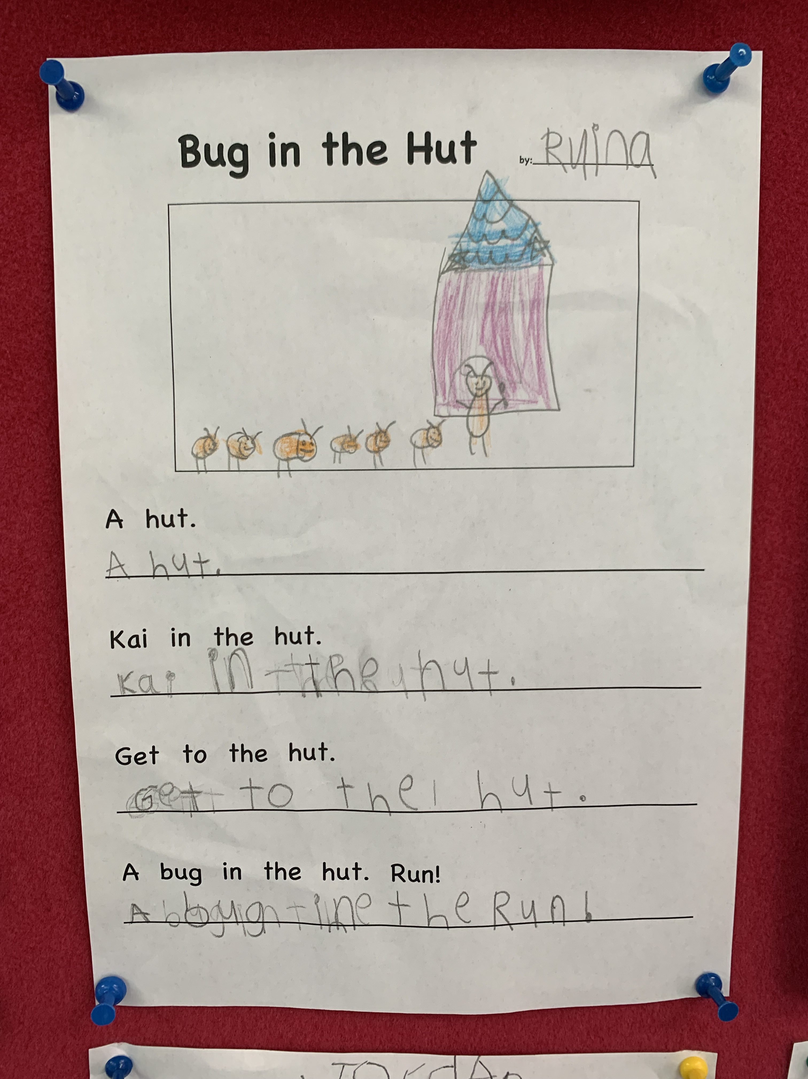
Looking deeper – BSLA
The Better Start Literacy Approach (BSLA) initiated at ACS in 2022
a structured approach to literacy instruction
based on NZ research,
supports early Reading, Writing and Oral Language development.
uses systematic teaching of critical phonological awareness skills and letter sound knowledge skills through games, explicit links to reading and spelling and structured small group reading sessions.
is a joint partnership with the University of Canterbury and the Ministry of Education.
It’s impact is best seen by review of Six Year Observational Survey

Slide 53
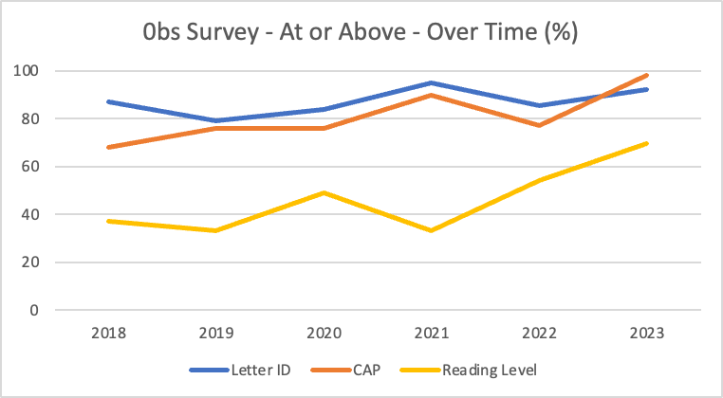
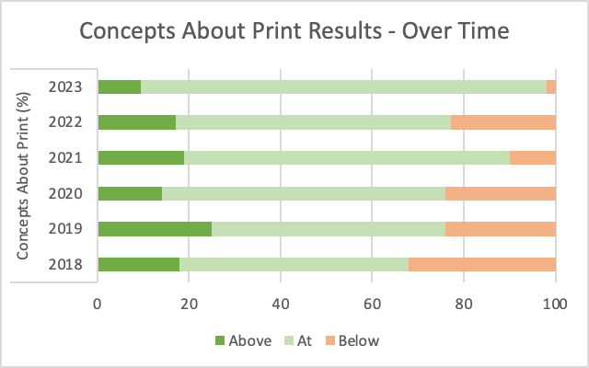
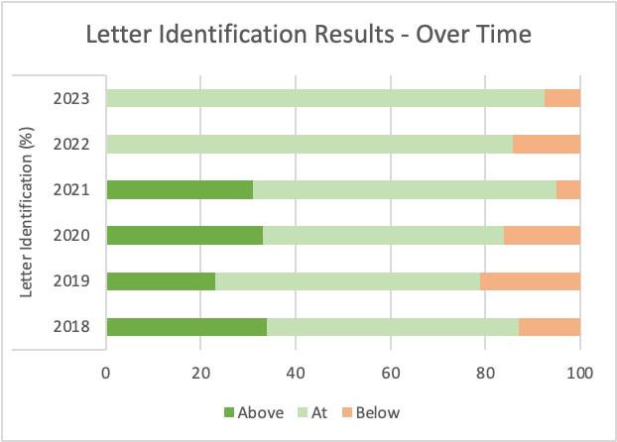
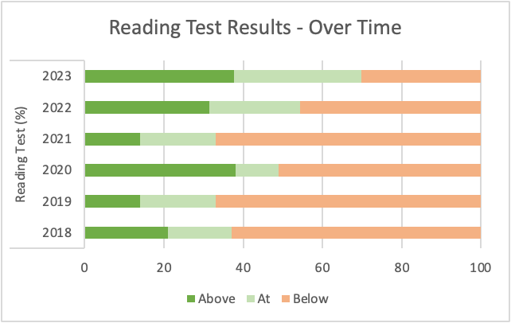
Looking deeper – BSLA
The graphs for: Six Year Observational Survey. BSLA introduced in 2022. Note the shift!

Slide 54
Looking deeper – Te reo
 | 2021 Median Scores |  | 2022 Median Scores |  | 2023 Median Scores
 | Start of Year | End of Year | Start of Year | End of Year | Start of Year | End of Year
Year 4 | 40.9 | 41.3 | 35.9 | 40.5 | 33.7 | 39.0
Year 8 | 46.4 | 51.1 | 47.2 | 50.9 | 45.9 | 52.3
This is the 4th year with a BOT-funded specialist te Reo teaching position in the school.
2021 was the first year we have collected standardised data in te Reo Māori.
In 2023 we once again administered the NCER Te Reo Māori assessment at Year 4 and Year 8 level, both at the beginning and end of the year.
The data collected, along with teacher judgement will contribute to our understanding, over time, of the achievement in te Reo Māori of our students and trends over time. NZCER does not test speaking, writing and presenting

Slide 55
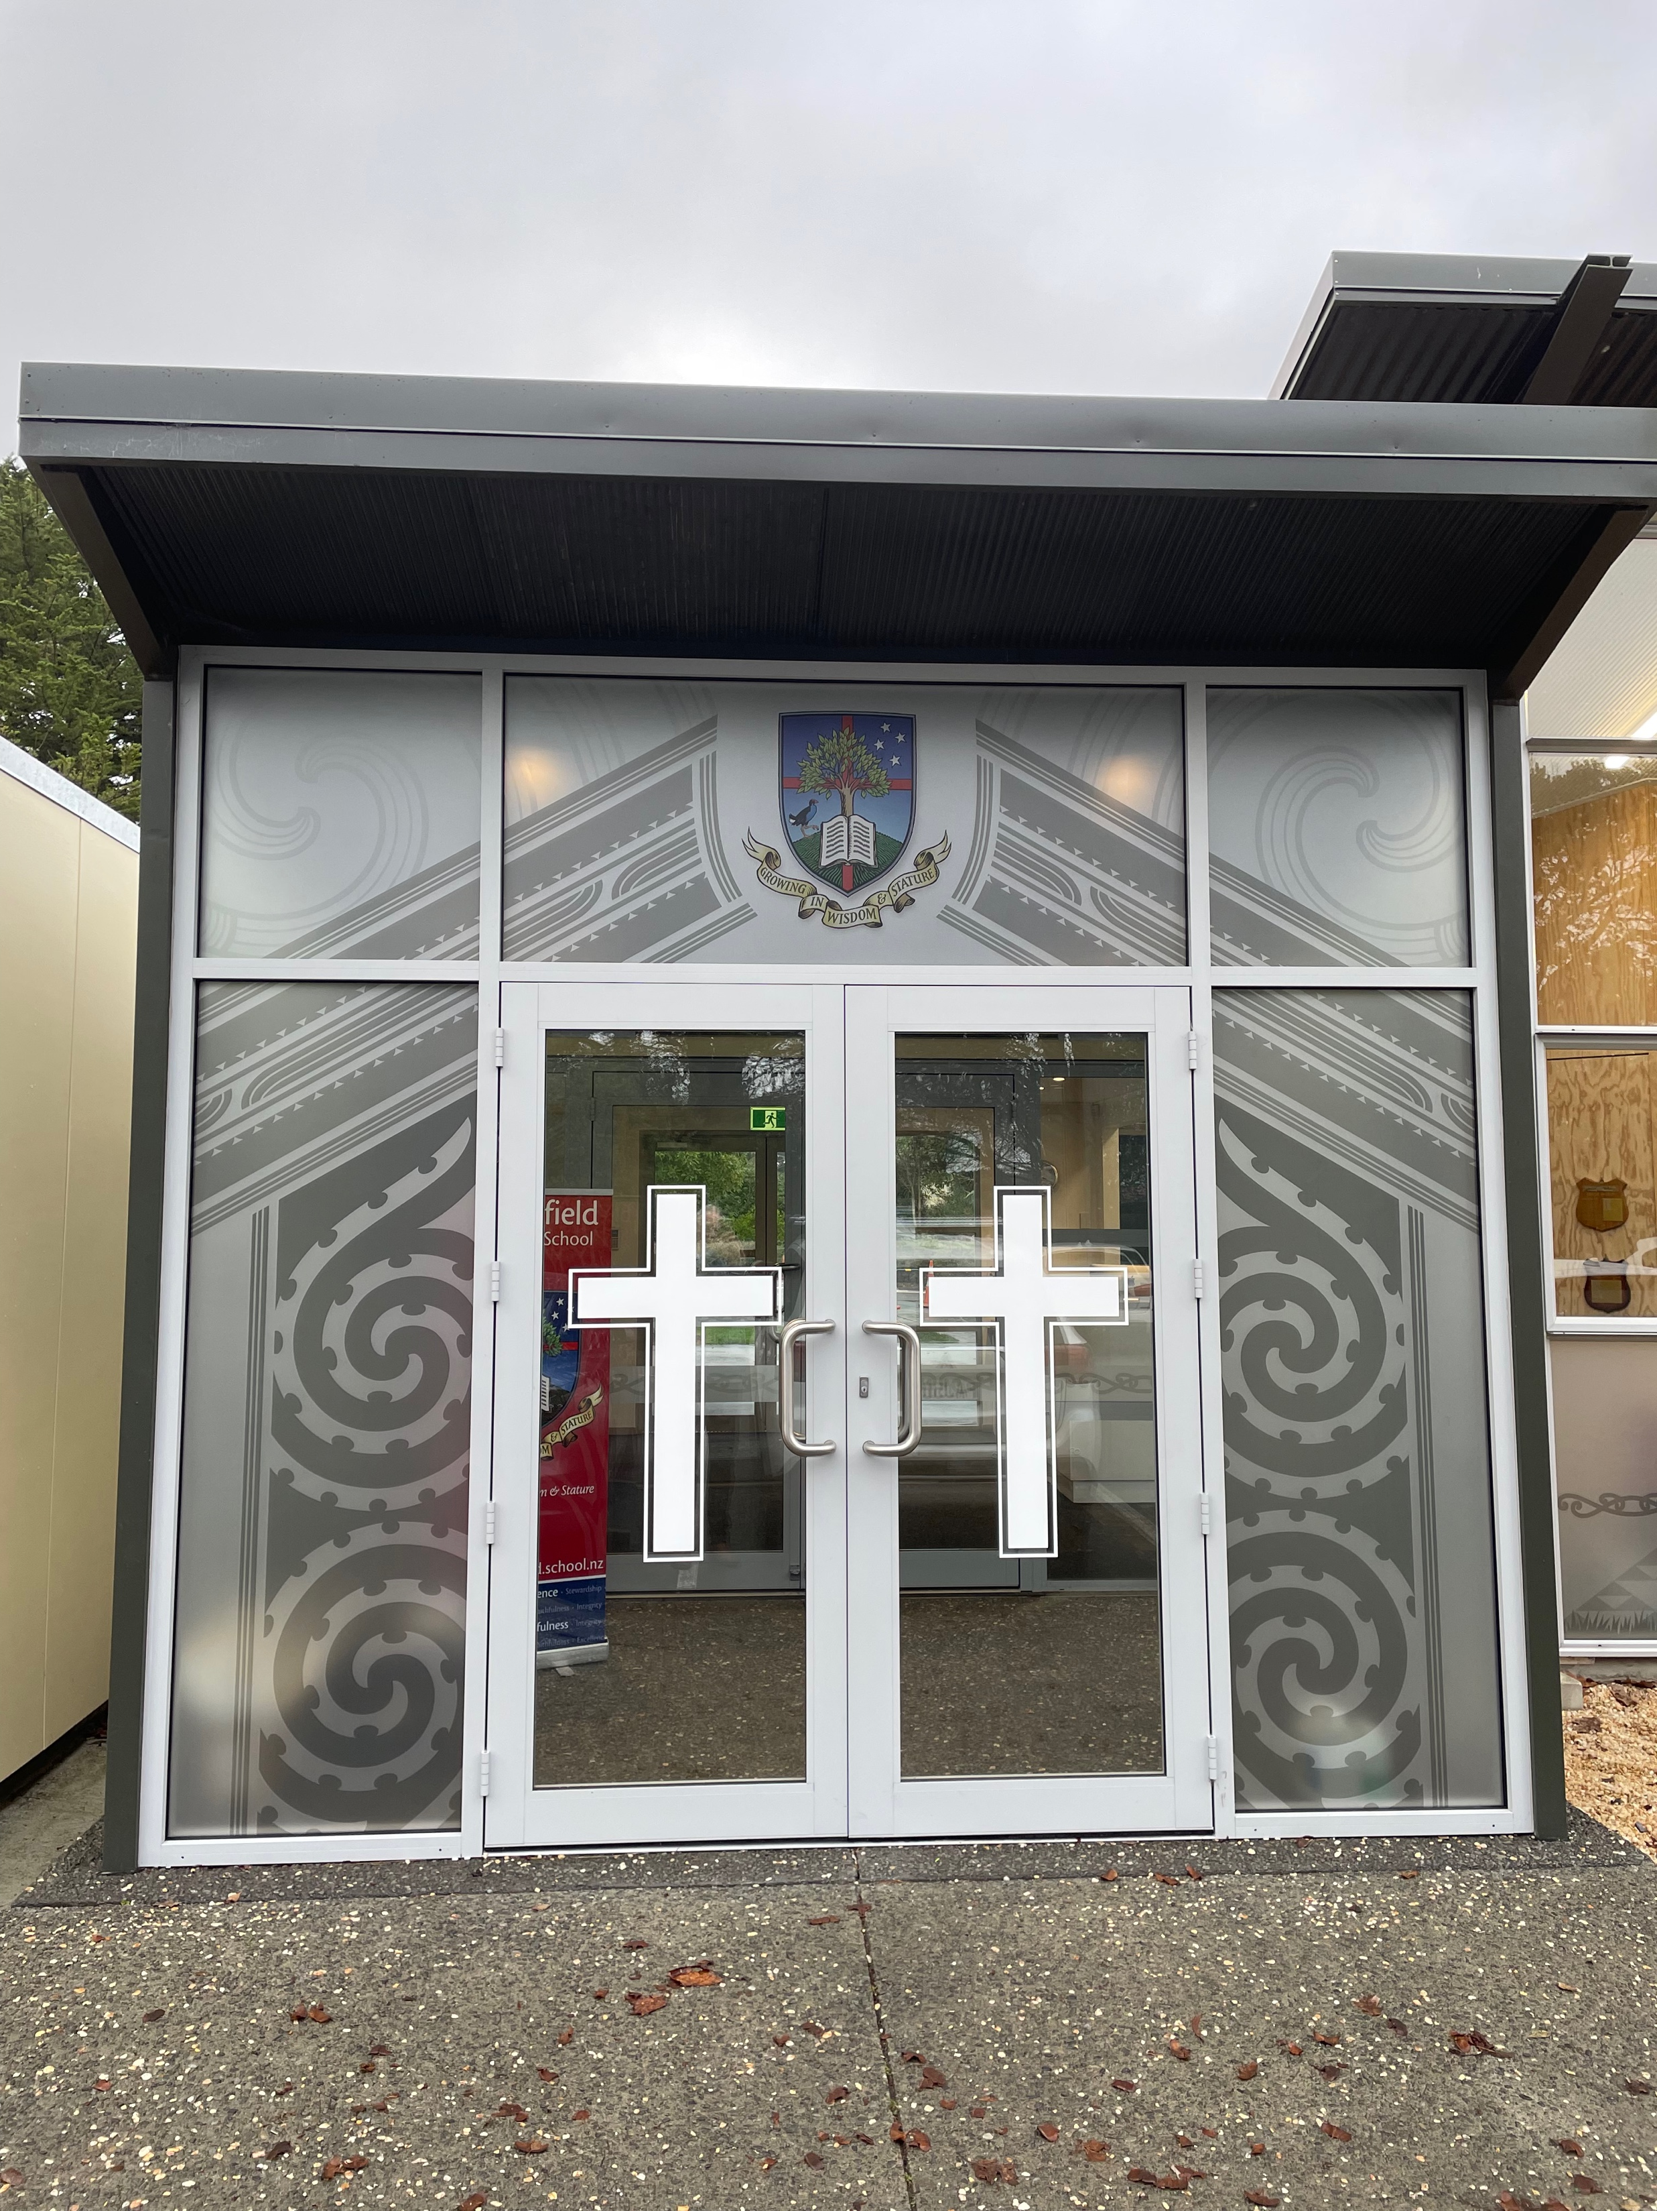
Looking deeper – Te reo
Anecdotal feedback in classrooms and through in-class assessment indicate that students:
continue to increase their knowledge of te Reo Māori,
have increasing expectation that te Reo Māori is a 'normal' part of learning
continue improvement in pronunciation and fluency
Students are beginning to use te Reo more flexibly – an example of this is recent learning in the area of pangarau (mathematics) in our upper primary classrooms. Students were able to take the learning in te Reo and use this to grow their understanding of place value, analogue time and money concepts. Te Reo Māori in this instance, rather than detract from students' understanding, was able to enhance it, as concepts around place value are well embedded within the Māori concept of number.

Slide 56
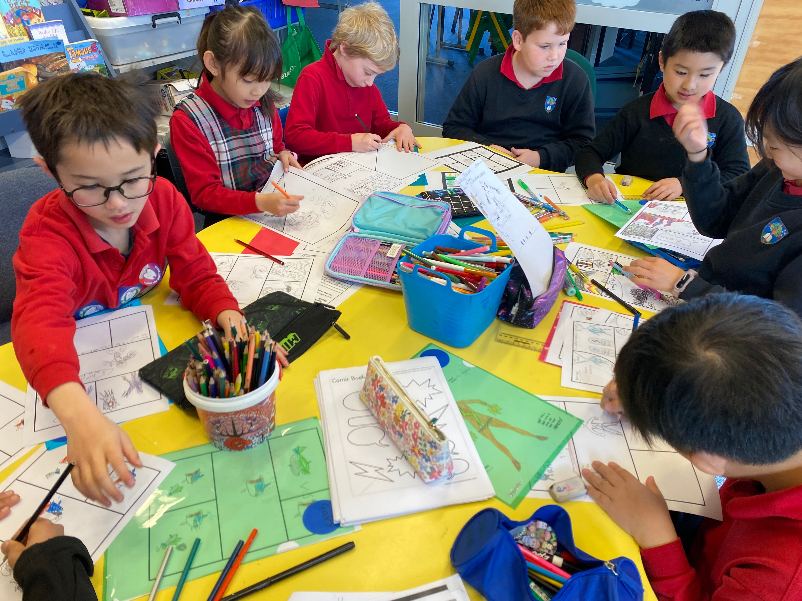
More than numbers
Data - numbers - tell a story about learning and achievement. Often there is a story within the story. Our staff have reflected on the year and the story of 2023 – things that bought them joy.
“A moment that has stuck with me was our 2 day interschool ‘Inventionator’ competition. During that time I saw our kids rise to the challenge academically but even more than that was seeing the expression of Jesus in them in the way they connected with students from other schools. Many were prepared to step up and show outstanding leadership but with a layer of kindness and servant-heartedness. It made me realise that there is indeed an outworking of our "special character" in very real ways.”
“I have loved the way the students with significant differences (whether they be learning, physical or social) are integrated into our place with comparative ease…. our kids welcome them, love them, include them, help them, sit alongside them, …of course not all students are as warm and wonderful as the ones I'm speaking of, but for those who have struggled thus far in life, I hear stories of inclusion, non-judgemental acceptance, lack of bullying, just Christ's love in action.”

Slide 57
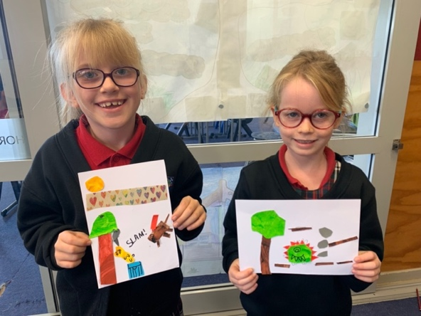
Looking deeper – Fostering Strengths
Fostering Strengths 2023 - to cater for the learning needs of students identified as having special abilities.
Identification of gifts is a multi-categorical approach.
Two year goal - every child being given the opportunity to be in a Fostering Strengths group by the end of their Primary schooling. As at December 2023 all our Year 6 pupils who have been at our school for a full year or more, have had the opportunity to be part of a Fostering Strengths group.
2023 pilot programme for our gifted Year 7-8 students called E2S (Enabled To Serve).
11 students, one afternoon a week for the year.
Kathryn Renner facilitated working with a different theme each term.
Term 1: Intelligence – history, biblical view, Māori view, cultural perception
Term 2: Design Thinking – the process of design thinking and an interschool competition (with 2 of our students in the winning team)
Term 3: Passion Projects – individual research, experimenting and
presenting
Term 4: Plan to Podcast – creating a professional podcast –
scripting, interviewing, recording and audio editing in conjunction
with Christchurch City Library.

Slide 58
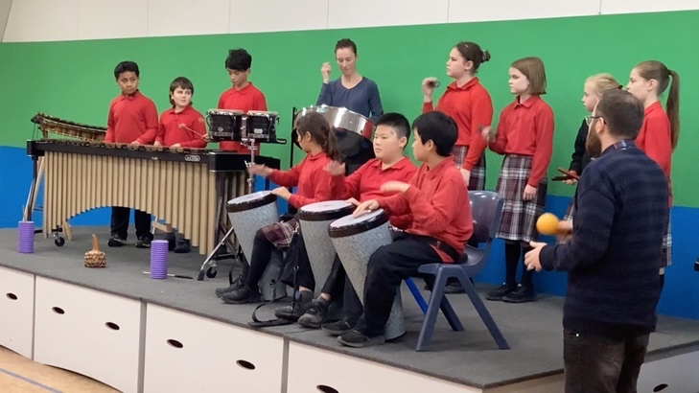
Looking deeper – Fostering Strengths
Programmes and Opportunities offered in 2023
Year 1-2 - Drama, Music, Play Script Writing, Social Outreach, Maths, Science
Year 3-4 - Maths, Social Outreach, Comic Design, Ukulele, Pasifika Dance, Reading, Art, Sewing
Year 5-6 - Maths, Engineering, Mission, Science, Future Problem Solving, Netball, Percussion Drumming
Year 7-8 - Gifted Extension Group, Art – Painting and Design
2023 = 173 pupils throughout the year in Fostering Strengths groups
pupils throughout the year in Fostering Strengths groups: 2022 = 126; 2021 = 116

Slide 59
Looking deeper - ELL
English Language Learners 2023
Number of Ministry of Education (MOE) funded learners = 65
21 migrant, 44 NZ born
11 Middle School, 54 Primary school
Languages spoken at home:
Mandarin | Korean
Shona, | Sinhalese
Portuguese | Hindi
Tagalog, | Tongan,
Khmer, | Cantonese,
Japanese | Afrikaans
Fijian | German
Yoruba

Slide 60
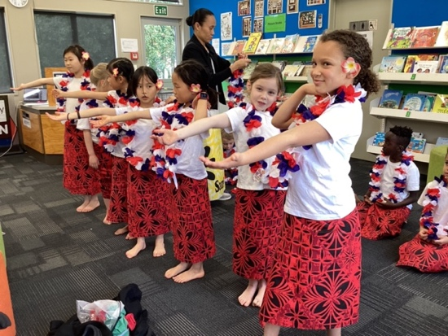
Looking Deeper - ELL
Assessment data: progress shown within a two year period (2021 to 2023)
Of the 60 identified ELL students (Year 2 and above) in 2021,
78% (47/60) are at or above in reading at EOY 2023
73% (44/60) are at or above in writing at EOY 2023
ELLs are making positive gains in both reading and writing, which are close to those of their native English speaking peers. (For example, 85% of all students are at or above for reading.) The research suggests it can take 5-7 years to learn academic language (Ministry of Education, 2008) so this is significant progress in only two years.
We believe this is due to a combination of strong classroom teaching, specialist language support and partnering with families.

Slide 61
Looking deeper – learning support
Core tasks in Learning Support include:
Working alongside teachers to support those pupils who most struggle with learning in a range of ‘life’ - academic, social, physical, spiritual areas.
Contributing to IEP information – progress and goal setting for IEPs as appropriate
Assisting in a classroom in a variety of ways
Assisting with transition plans for children with significant need
Monitoring and updating information around children with significant health issues
 | 2020 | 2021 | 2022 | 2023
ORS funded students, | 5 | 4 | 4 | 3 | ORS : Ongoing Resourcing Scheme) funding. This is covering children with significant needs to be supported for up to 13 hours per week.
MoE funded – health/speech etc | 5 | 3 | 3 | 2
IEP in place | 6 | 7 | 7 | 8 | IEP: Individual Education Plan, reviewed twice yearly in conjunction with parent,
RTLB funded (part year) | 2 | 1 | 1 | 2 | RTLB: Resource Teacher of Learning and Behaviour: Specialist teachers who support SENCO in application, assist with initial observations and suggested pathways for diagnoses. They also upskill the SENCO and will work with individuals for a short period of time when Ministry support is not an option, yet the child does need significant support.

Slide 62
Looking deeper – learning support
 | 2020 | 2021 | 2022 | 2023
School funded individuals | 3 | 5 | 5 9 | 14 9 | TA support in classrooms, .1 specialist teacher BSLA Phonological support – small groups, targeted support, led by a teacher
Learning Support Profiles and Health Plan | 29 11 | 30 13 | 22 19 | 21 1
Reading Recovery Monitoring of discontinued children | 13 | 13 | 16 | 16
Maths Support | - | 13 | 26 | 23 | Small groups Year 3-6, very targeted support, led by a teacher
Specialist referrals e.g. Seabrook MacKenzie, Anstice Optometrist |  |  | 1 | 6
SAC Applications |  |  | 4 | 3
Teacher Aide hours | 96 SOY 6 TAs 73 EOY 7 TAs | 62 SOY 5 TAs 75 EOY 9TAs | 80 SOY 8 TA’s 92 EOY 9 TA’s | 93 SOY 8 TA’s 87 EOY 10 TA’s | These hours include: In class support, ORS funding – this was reduced at the end of 2021, but ACS maintained a higher level of support New Entrant Talk To Learn programme, aimed at increasing confidence and clarity when speaking Speech Language support RTLB funded interventions Health needs e.g toileting New children transitions TA Professional Development Emotional regulation programmes either 1:1 or in small groups for short periods The funding from increased International roll enabled us to provide support for some other children in class

Slide 63
More than numbers
Data – numbers - tell a story about learning and achievement. Often there is a story within the story. Our staff have reflected on the year and the story of 2023 – things that bought them joy.
“One of my students struggles with anxiety. She often froze when something new came up. She wouldn't try new things- only with immense encouragement. She never shared news and declined most time to be the class leader and to share her pepeha. Recently this changed. The other day, we were sitting on the mat about to read a story. Her hand shot up and she asked if she could read it. Wow! She was amazing. She had a great story telling voice and used lots of expression. About the same time, she said yes to being the leader and shared her pepeha. She bought news for the first time this year. Her confidence is growing! It has taken a while, and I am sure that it will continue to be a journey for her, but I am so glad that she is on her way to being confident! ”

Slide 64
2023 Analysis of Variance
Quality education means all pupils in years 1 to 10 will have every opportunity to achieve to their expected level (as a minimum) against the National Curriculum by the end of the year
2023 has seen excellent progress across the school age levels and learning areas with many opportunities to learn and grow. We appear to oscillate around the 80% to 90% level across years. Some years very strong, some years strong.
God’s faithfulness and blessing is evident.
Excellence Faithfulness Integrity Stewardship

